Slide 1



E-Farmer’s Market
By :-
Govind Nair -- 1062
Kedar Apet -- 1090

Slide 2
Contents :-
Introduction
Technologies used
Modules
Proposed System
System Architecture
System Design
E-R Diagram
Use Case Diagram
Test Screens
Conclusion and Future Scope.
References

Slide 3
Introduction
The application's main concept is to allow customers to shop virtually
over the internet for products of their choice.
The Producer(Farmer) can add/remove crops according to his crops
production.
The Buyer can see his shopping cart and can manage the shopping
cart and the quantity of the crops and can place an order.
Hence, there is hassle free experience of purchasing the crops
directly from the farmer online.

Slide 4
Technologies Used
Backend :
Spring Boot
REST api
Spring Data JPA
Frontend :
React
CSS
html
Bootstrap 5

Slide 5
Modules
User Module
Producer Module
Can register
Can Add/remove crops as well as their quanties
Can manage the crops price.
Buyer Module
Can register
Can see the all the crops and their details
Can add the crops to his/her shopping cart and manage the cart
and see the total price.
Can order the crops and see the order placed.

Slide 6
Proposed System
User Friendly UI
Need to be the registered user to see the crops and order them
Add to the Shopping cart
Order placement
Crops add/remove by farmer

Slide 7
System Architecture
Three Tier System Architecture
1.The application will follow three-tiers architecture and will run on client/server
model
2.The client only displays the GUI and data but has no part in producing results.
Client/Presentation Tier
Business Logic Tier
Data Tier

Slide 8
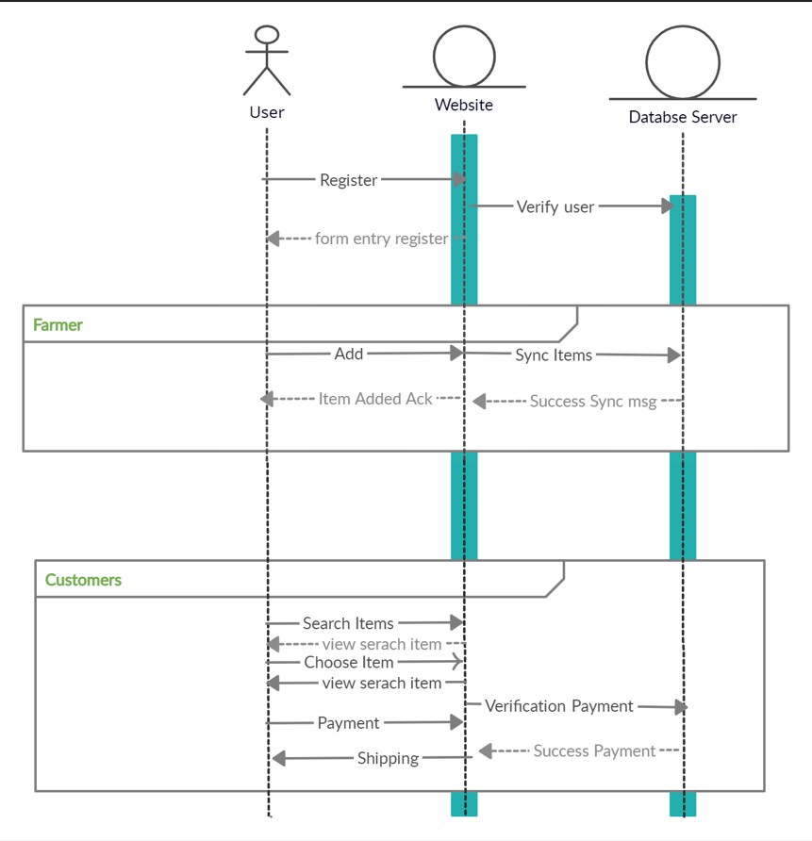
System Design

Slide 9
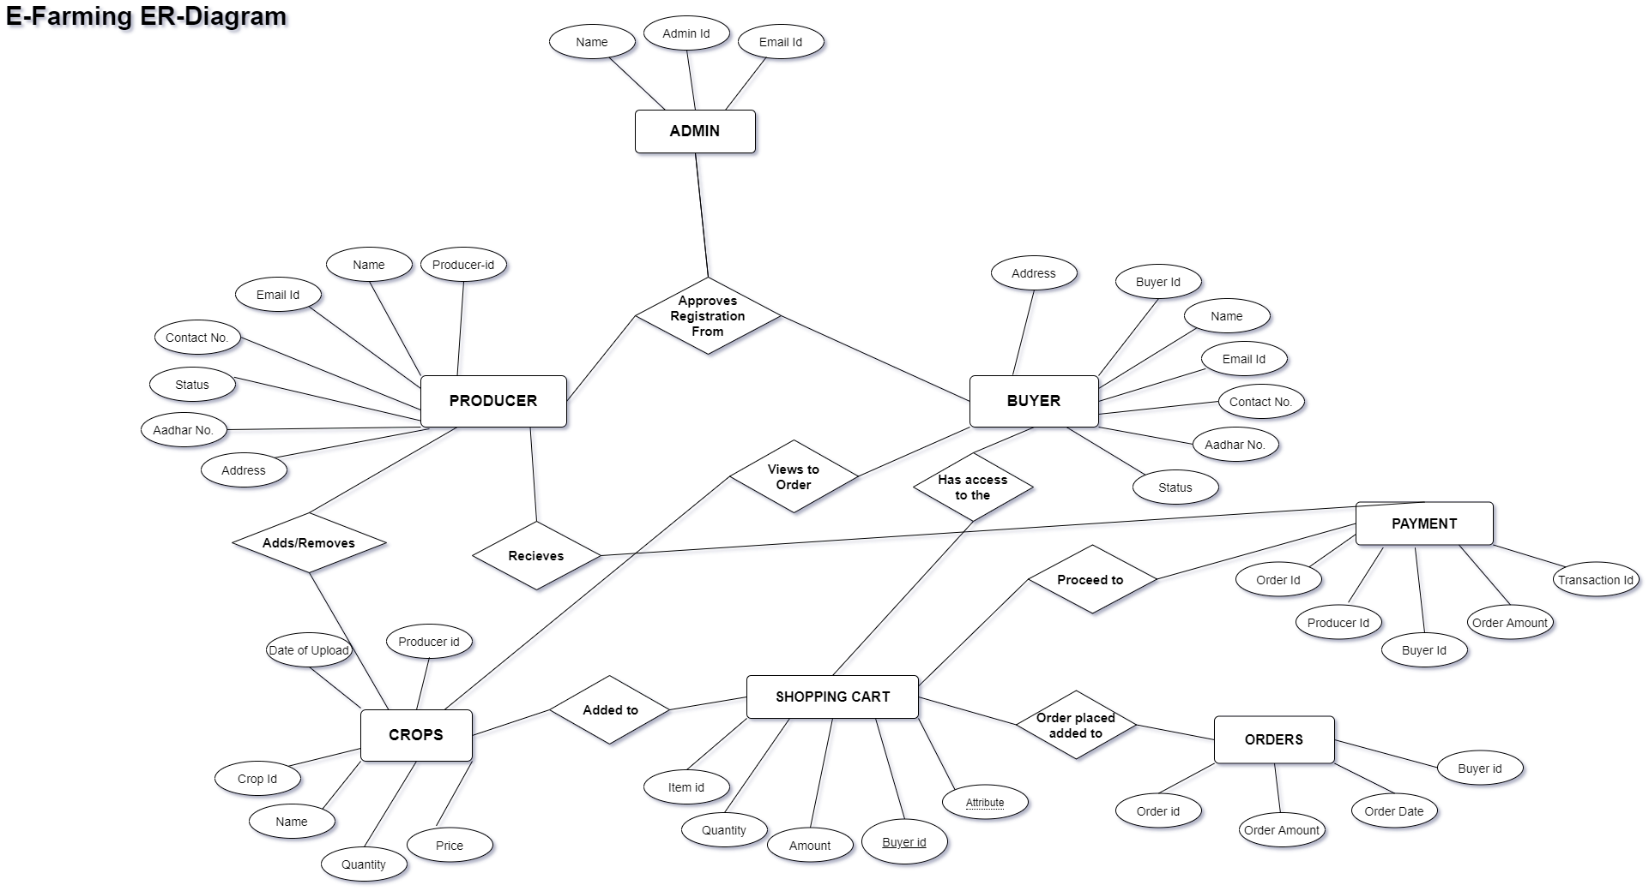
E-R Diagram

Slide 10
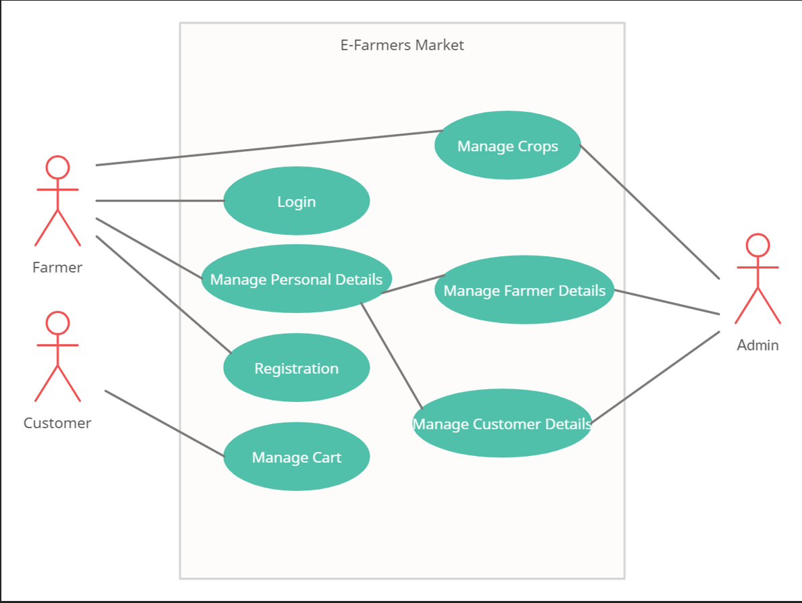
Use Case Diagram

Slide 11
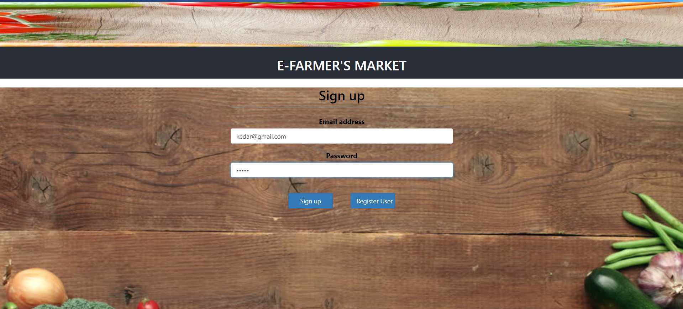
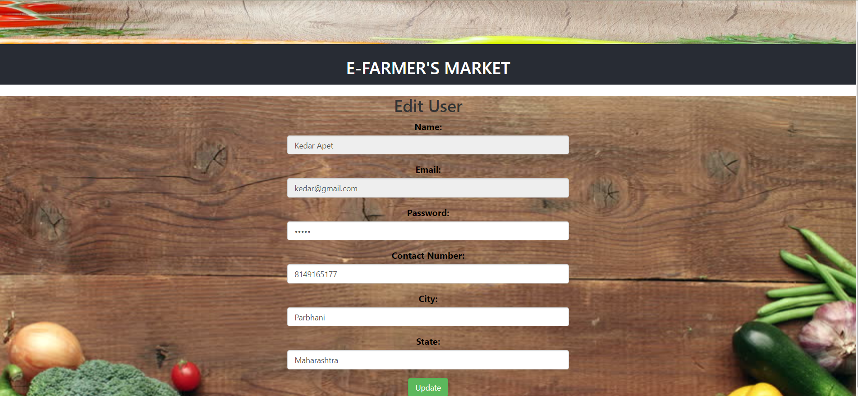
Test Screens

Slide 12
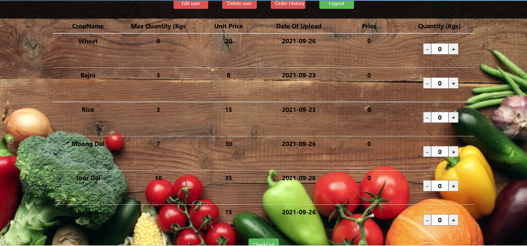
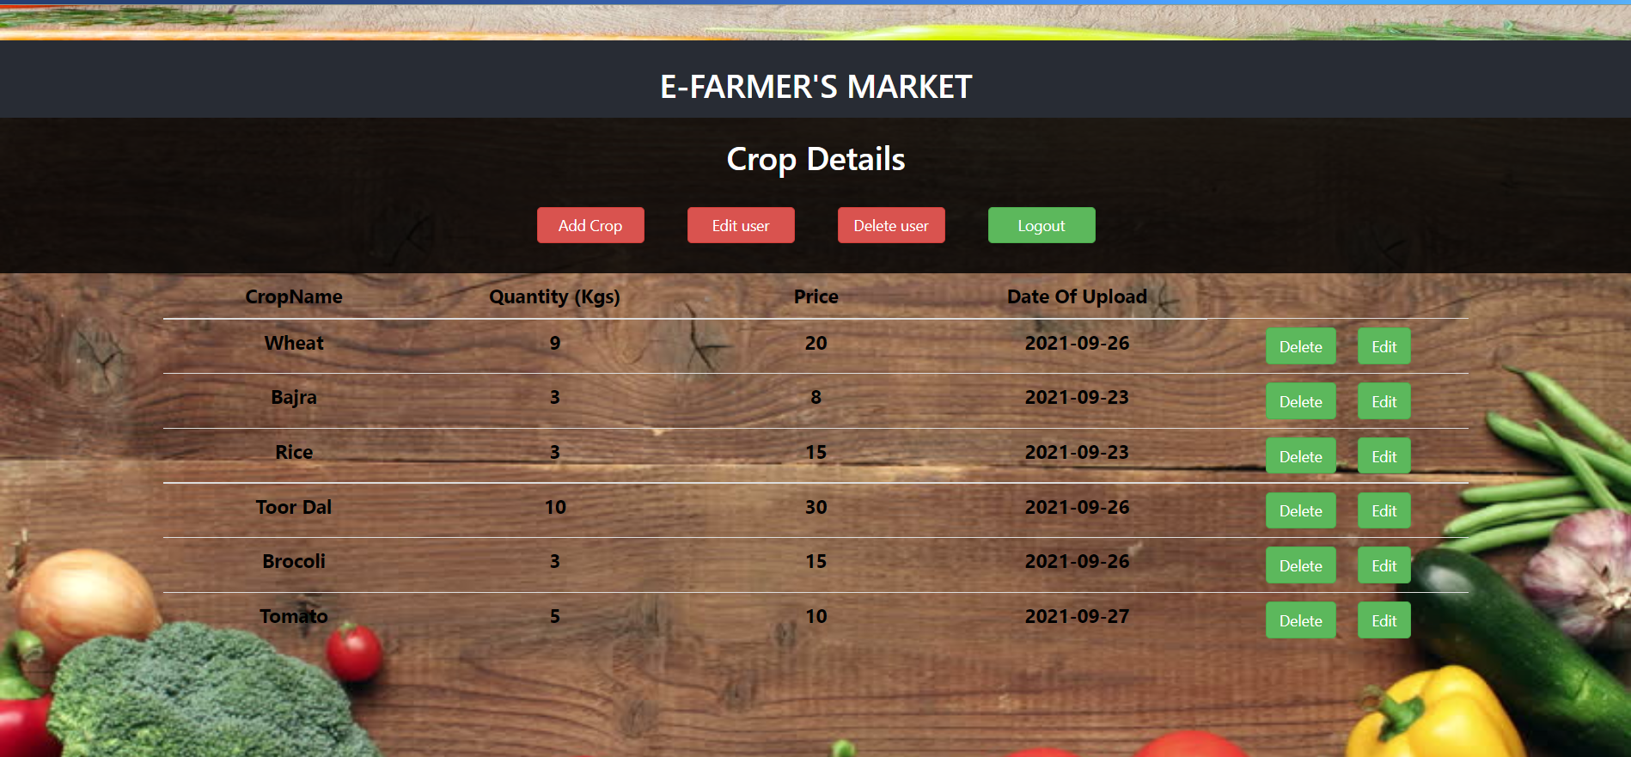

Slide 13
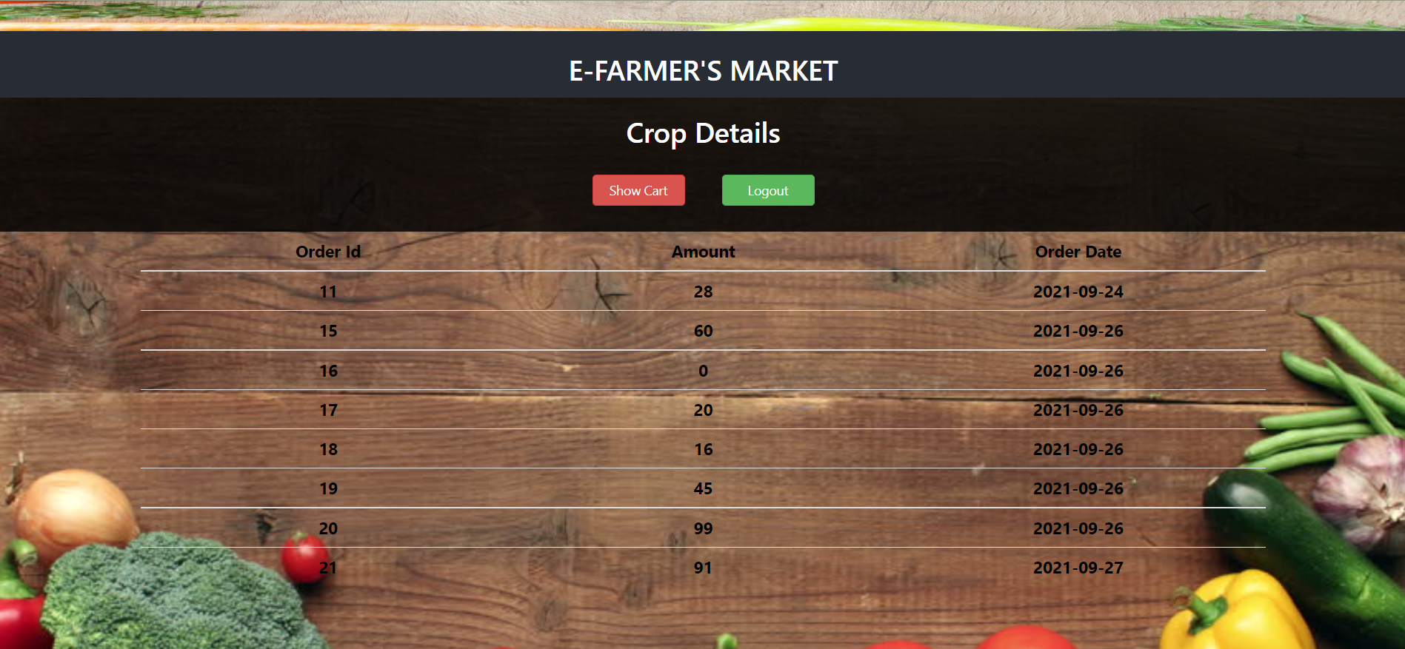
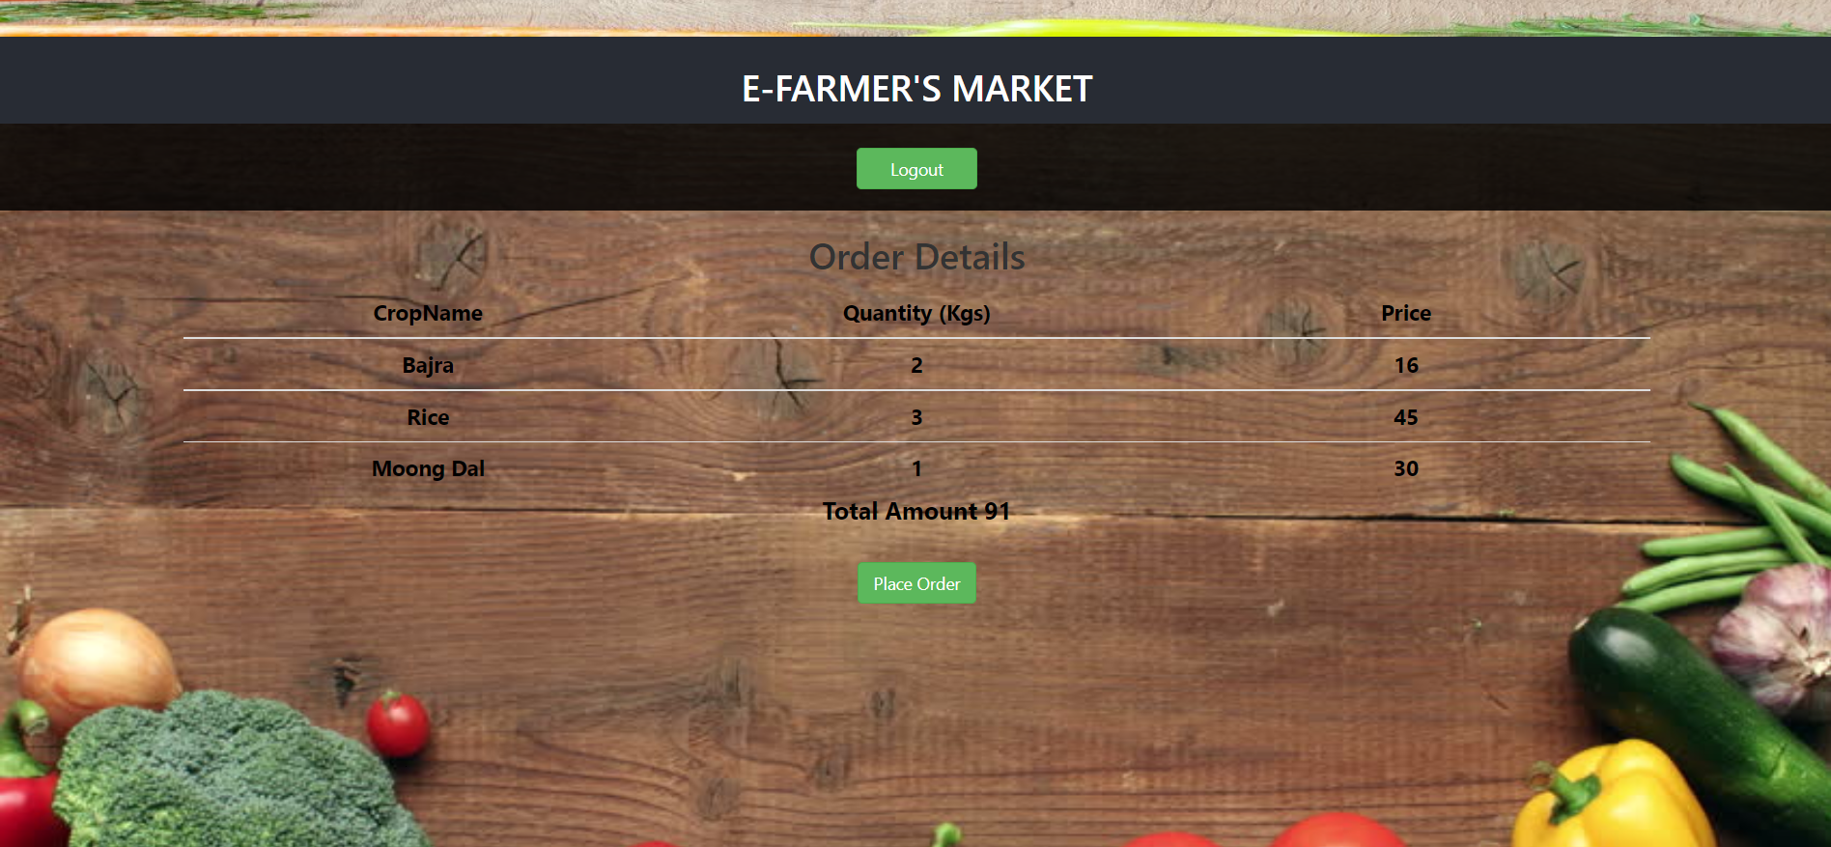
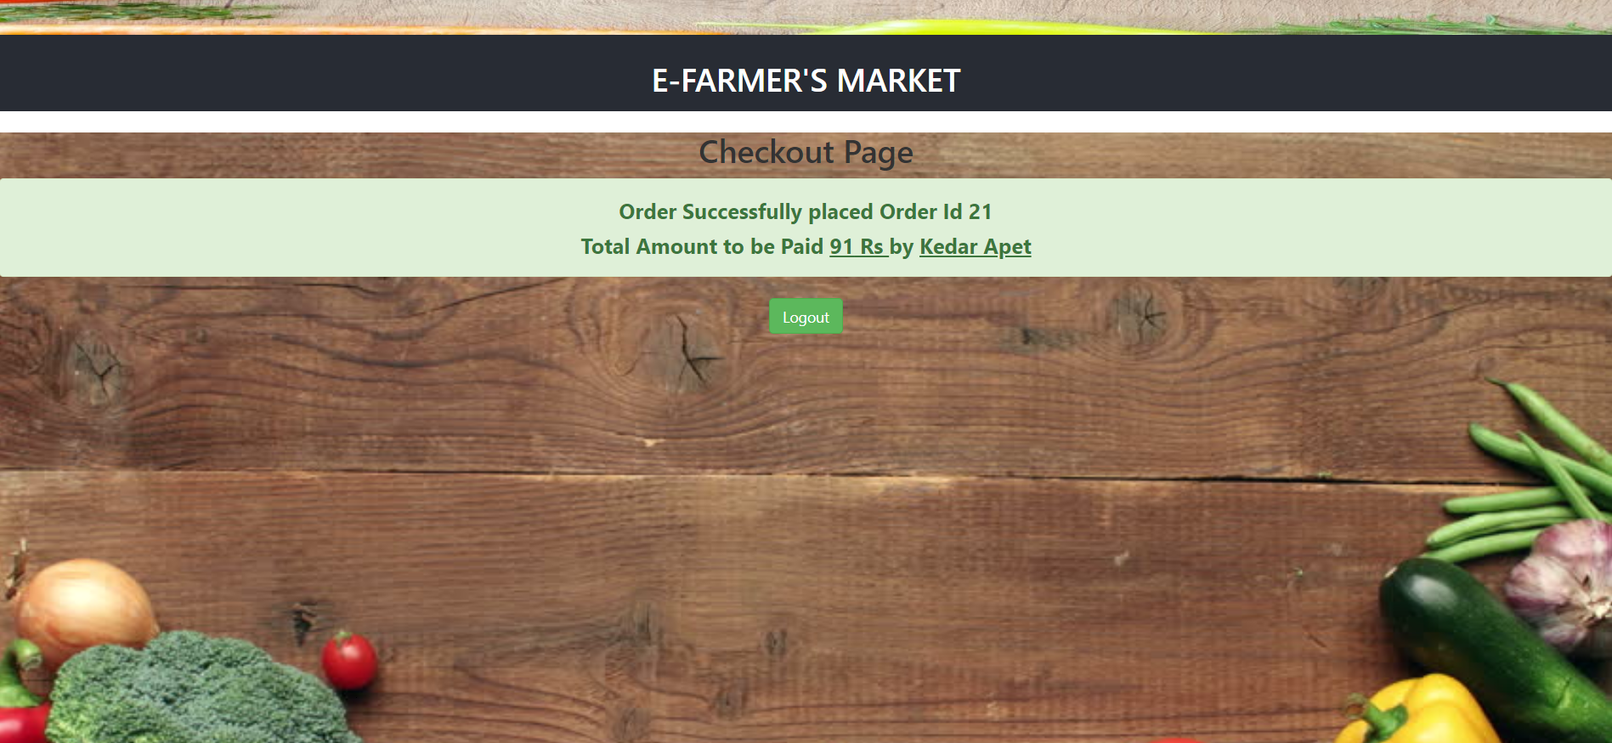

Slide 14

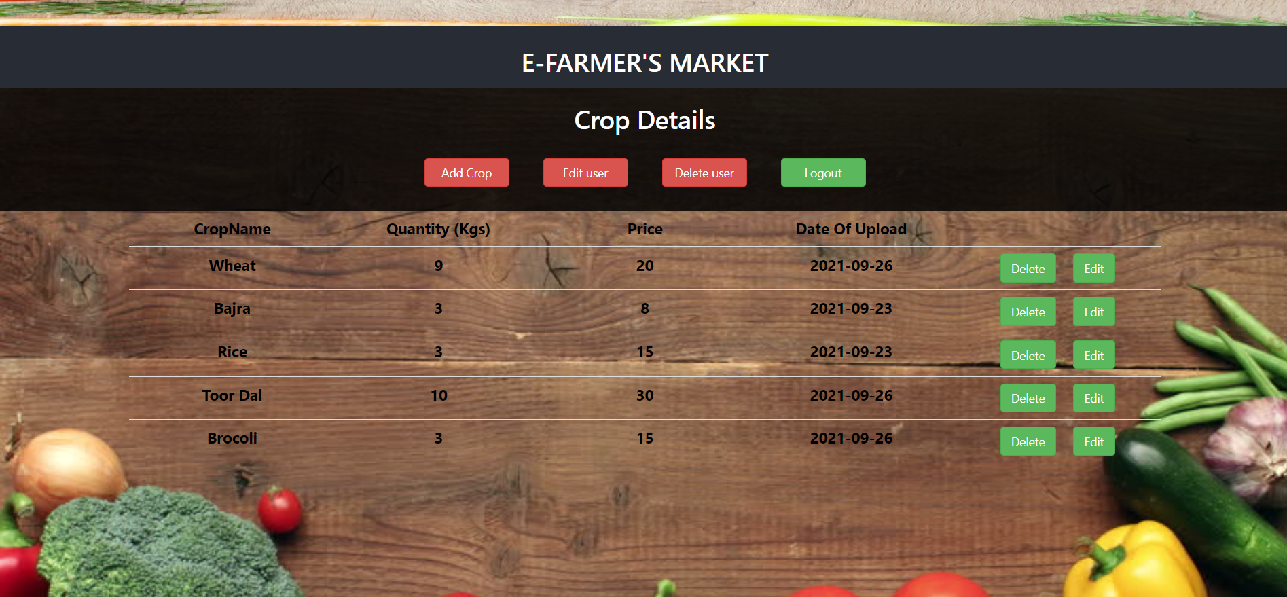
Producer Flow :-

Slide 15
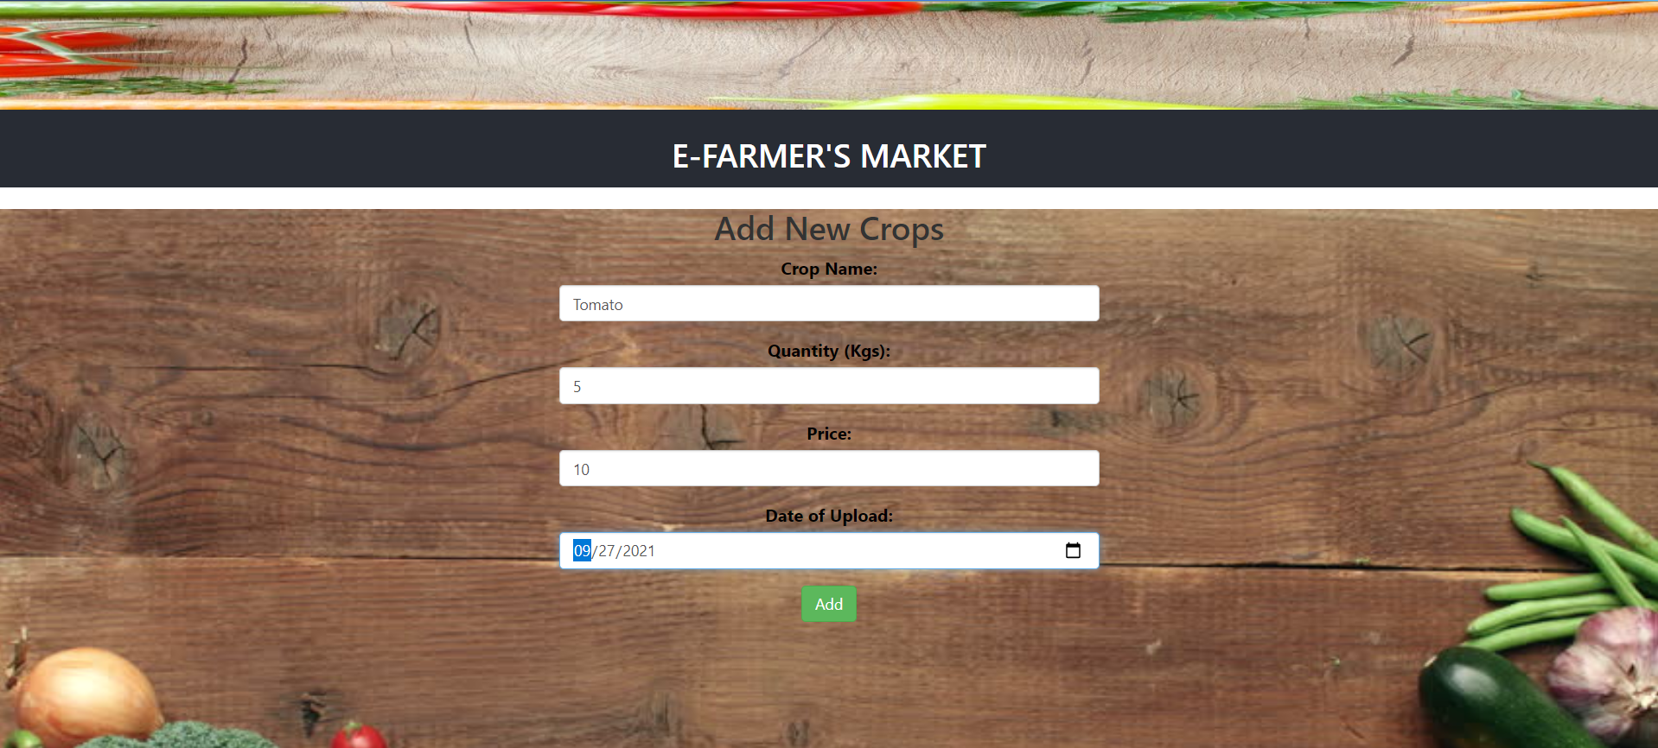
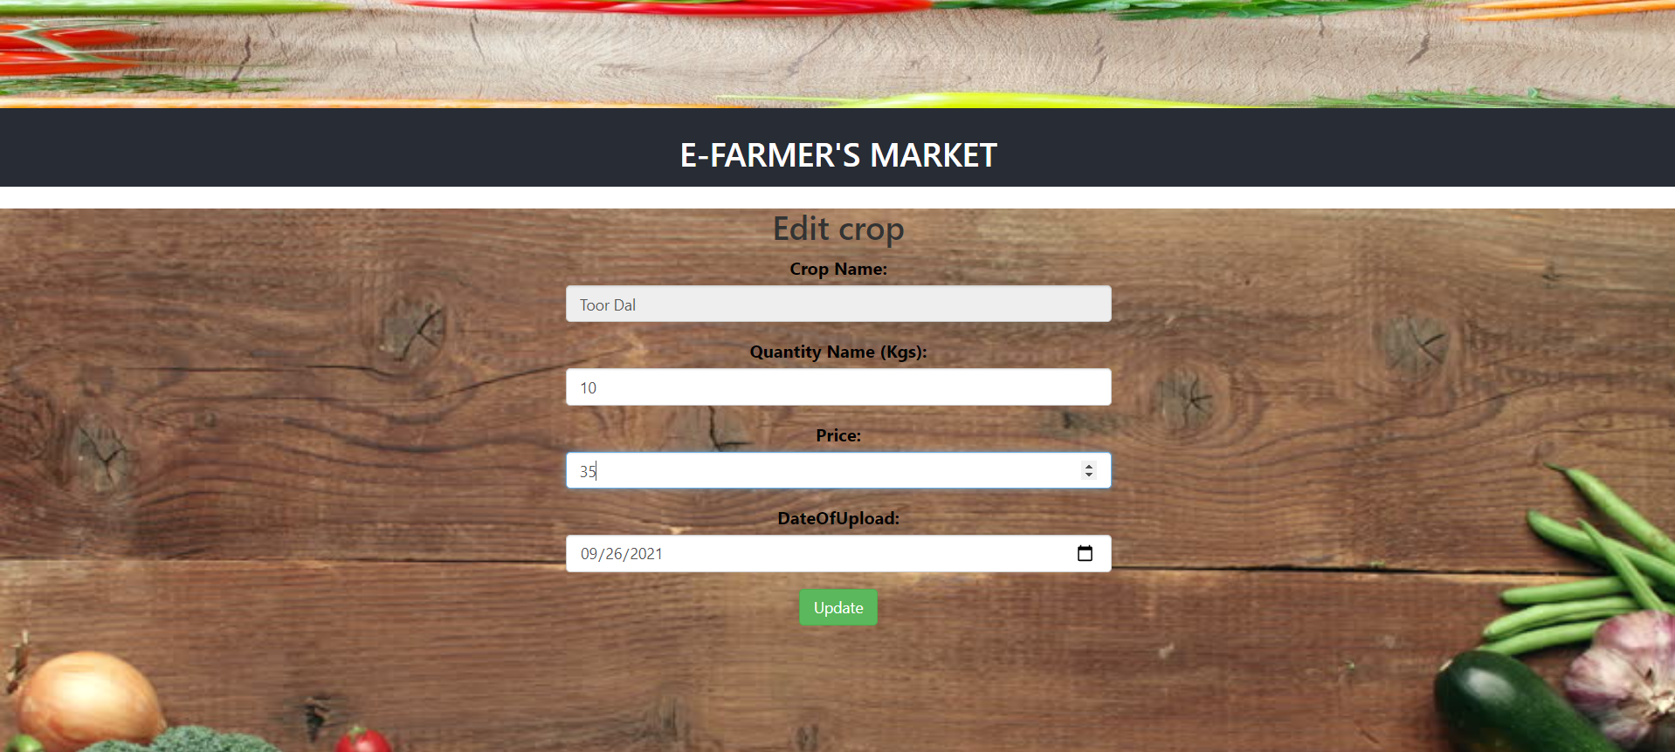

Slide 16
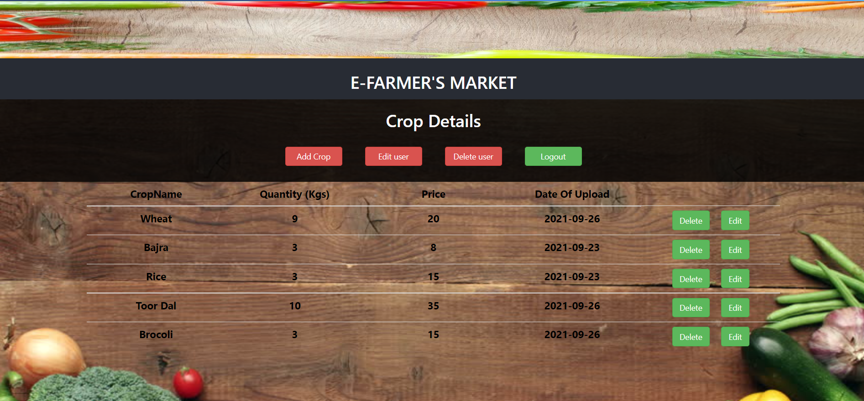
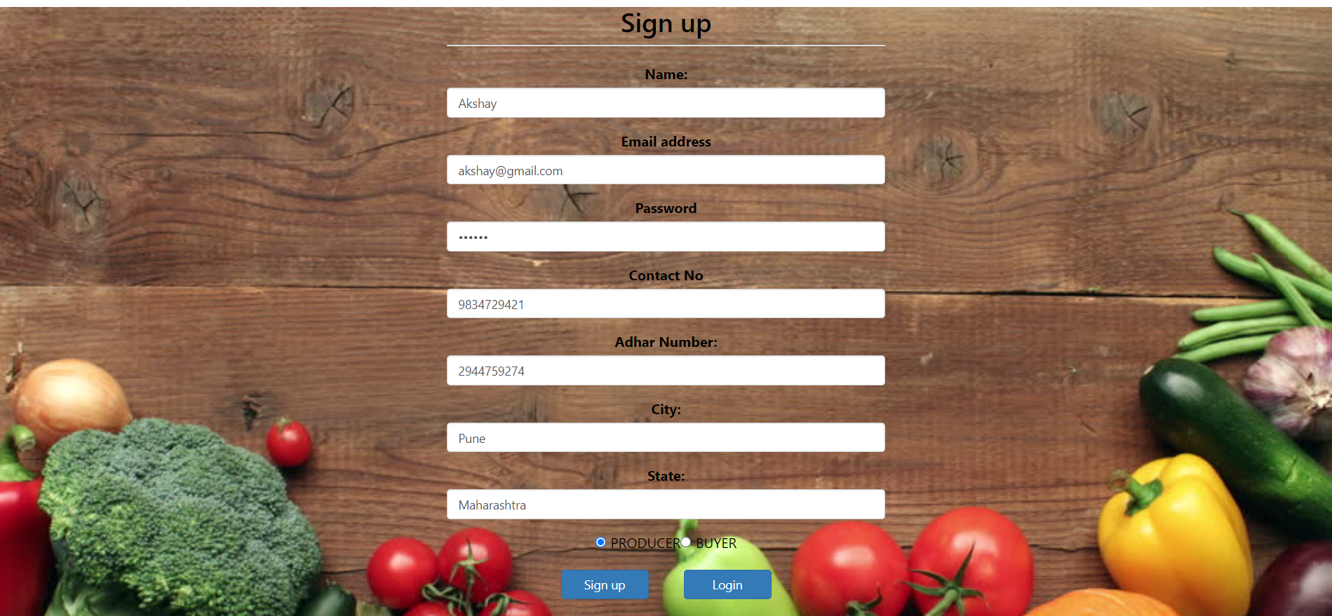

Slide 17
Conclusion and Future Scope
The main motive for the project was to provide dynamic online farmer’s management system to help farmers in every possible way and provide
them a stable platform where they can perform every transaction with
ease.
FUTURE SCOPE
Payment Gateway :
In this project we have designed false transaction which will show only that transaction is successful, similar to virtual transaction for better understanding. Since the implementation of payment gateway is not possible right now, it will be implemented in future.

Slide 18
References
Offline References
[1] Object Oriented Analysis and Design with Applications by: Grady Booch, Ivar Jacobson, and
James Rumbaugh
[2] Software Engineering: Principles and Practice by: Hans van Vliet.
[3] SQL Notes from www.GoalKicker.com.
Online References
www.google.com.
Wikipedia.com.
http://farmersweb.com/
Java and Other Official Documentations
http://localvendorscoalition.org/

